Slide 1
Virtual Programs with NASA Scientists
Virtual Programs with NASA Scientists are being offered through NASA@ My Library for the program’s Partner Libraries.
The programs are designed to create memorable experiences, by providing opportunities for patrons to “meet” and engage in meaningful two-way discussions with scientists.
We would like to record this; any concerns?
NASA@ My Library
NASA, public libraries, and state library agencies work together to increase and enhance STEM learning opportunities for millions of library patrons across the US, including geographic areas and populations that are currently underserved in STEM education.

Slide 2
Goals
We will work with libraries and scientists to conduct a program that creates a memorable experience for the library’s patrons.
Patrons are more interested in Earth or space science and aware of NASA science missions.
Library staff who help facilitate the programs are more interested in, knowledgeable about, and confident in delivering NASA-related programs.
We intend to provide you with opportunities to connect with underserved audiences, relaying NASA science and discoveries and your own personal journeys.

Slide 3
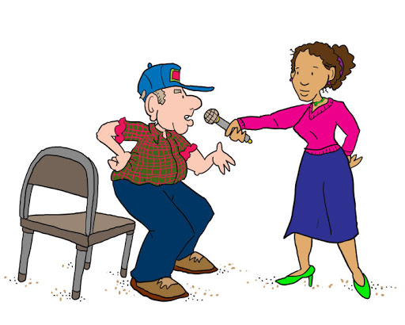
Please help us engage the participants
Engage patrons in learning:
Use descriptions that are relevant to the patrons.
Invite patrons to share their knowledge and experiences.
Create personal connections with the patrons.
Together, we will use activities to invite the patrons to play and discover things for themselves.
We plan to include questions and discoveries that surprise patrons.

Slide 4
Outline
Time What Who
- 30 minutes Log on to RingCentral Library and host
questions, check materials
- 20 minutes Log onto Ring Central Scientist
Review program outline Host leads
- 10 minutes Begin conversations with patrons, scientist Library
Start recording Host
0 minutes Welcome patrons Library
Introduce scientist Library
Poll And / Or question in the chat Host, Library
+ 5 minutes Start presentation Scientist
+ 15 minutes Thank scientist, start activity Library
Add observations, ask questions Scientist
Invite patrons to share observations or respond Library
+ 25 minutes Invite patron questions, discussion Library
additional polls? Host
+ 30 minutes Thank everyone, evaluation survey Library and host

Slide 5
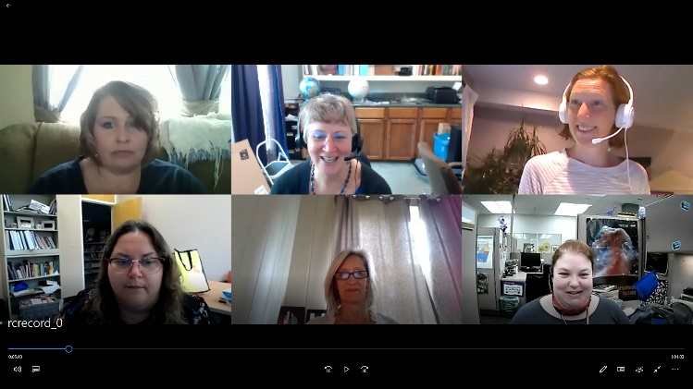
Cameras, Microphones, Recording
Cameras and Microphones:
Cameras and microphones enable greater participation and communication.
We will decide with the library whether to allow the patrons to share their microphones and cameras.

Slide 6
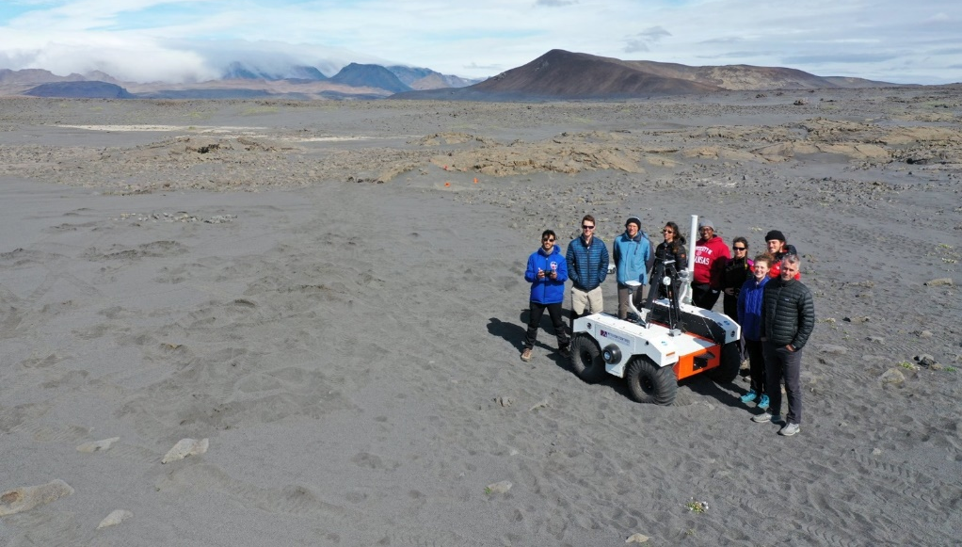
Best Practices in Enabling Meaningful Discussions
Create a comfortable / encouraging atmosphere:
We will invite patrons to participate from the very beginning of programs.
We will invite you to respond to the same question as the patrons.
Please help us keep the tone informal.
Make it personal:
Career
Hobbies
Field experiences
Interests

Slide 7
Questioning Strategies
Questioning strategies:
Use open-ended questions: avoid yes/no questions, questions with simple right or wrong answers.
Include questions about their experiences and knowledge: “Have you ever seen a ____ before?” “What do you know about ______?” “Why do you think that is?”
Include opportunities for patrons to share their observations: “What do you notice about ____?” “Can you tell me more?”
Use “wait time” (about 5 seconds) after asking a question before continuing.

Slide 8
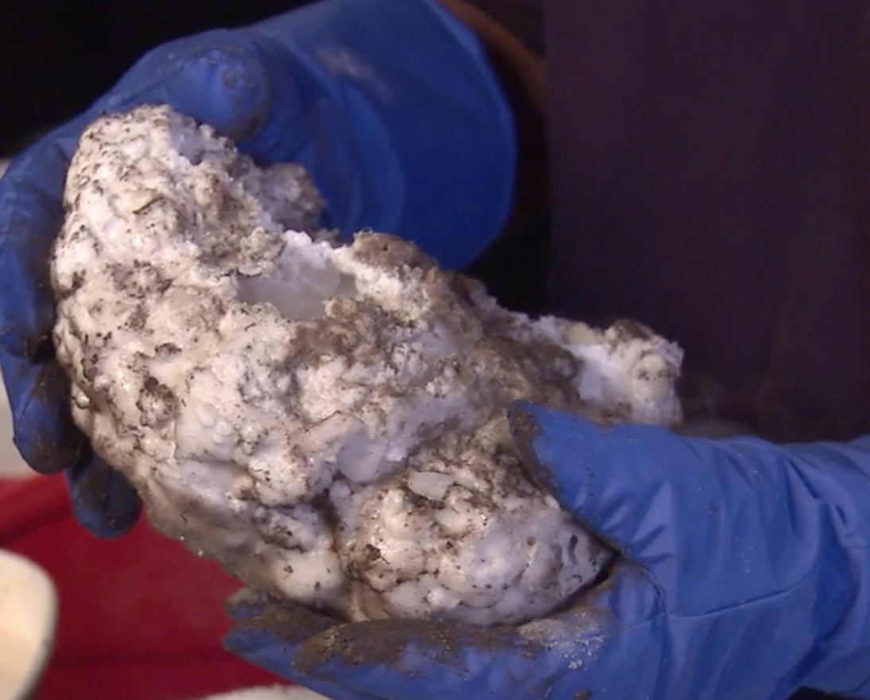
Activities
Comets Demonstration: create a model of a comet with dry ice, using directions for Recipe for a Comet (directions are in Kit B). Requires about $20 of materials, including dry ice, sand or soil, water, thick gloves, and small amounts of ammonia and syrup.
From the Moon and Back Again Demonstration: model impact craters, using directions from Crater Creations. Requires sand, flour, cocoa, a large box, and small rocks or marbles.
How To Be an Interplanetary Explorer Activity: lead a virtual version of the Mars Match Game with a powerpoint we provide.
Planetary Defenders Activity: lead a virtual game of Space Rocks, with the powerpoint we provide.
Roving on Mars Activity: use a robotic mouse and a map of Mars to program around hazards (Kit D) OR have patrons plan a route using a map you print and distribute OR plan the route using a map you share on your screen.
Searching for Alien Life Activity: Searching for Life, which can be conducted as a demonstration, during which you and Dr. Lynch will invite your patrons to make observations and share conclusions. All of the materials are within Kit D.

Slide 9
Activities
Comets Demonstration:
Create a model of a comet with dry ice.
Use directions for Recipe for a Comet (in Kit B).
Requires about $20 of materials, including dry ice, sand or soil, water, thick gloves, and small amounts of ammonia and syrup.
Options:
Possible substitutions?
Use IR camera? Thermometer?
https://www.youtube.com/watch?v=ZWWEizujOQA&list=PLvQkYyArNCy1U2R2fn1ugXaJ0EnqX4FaN&index=8&t=3s

Slide 10
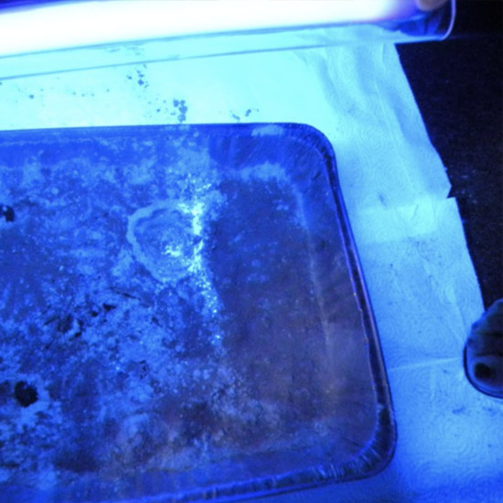
Activities
From the Moon and Back Again Demonstration
Model impact craters, using directions from Crater Creations.
Requires sand, flour, cocoa, a large box, and small rocks or marbles.
Options:
Possible substitutions?
Use UV camera and laundry detergent?
Make slow-motion video?

Slide 11
Activities
How To Be an Interplanetary Explorer Activity:
Lead a virtual version of the Mars Match Game with a powerpoint we provide.
Patrons share responses in the chat box.
Ask another staff person, host, or scientist to describe patrons’ responses.
Options:
Whole group effort (to get to a certain number of points?)
Teams?
Individuals; they each keep score?

Slide 12
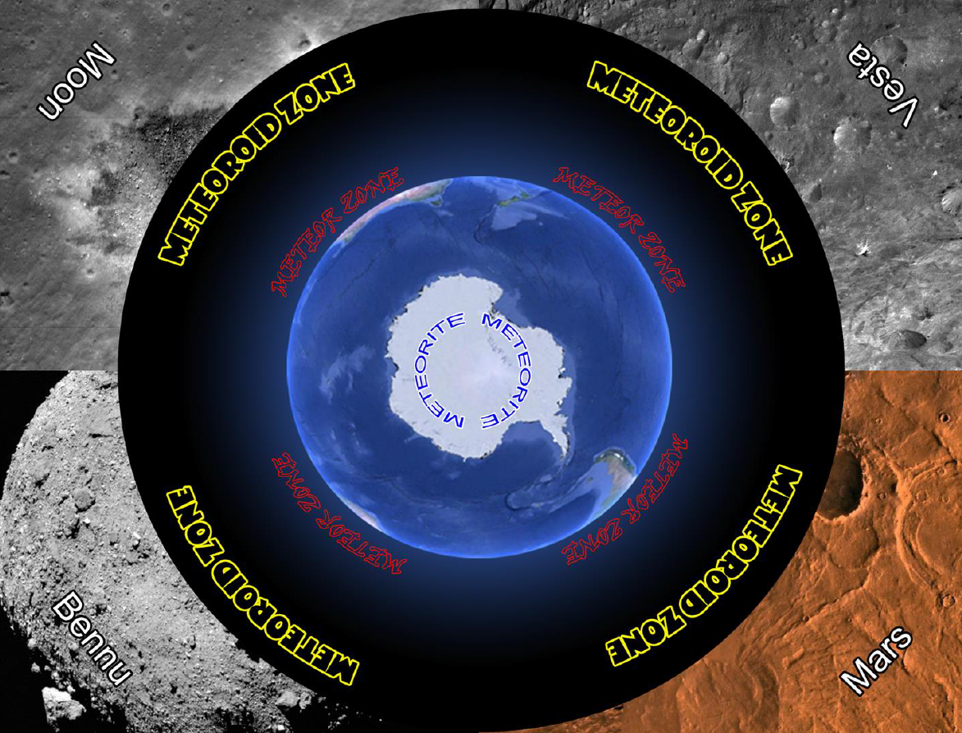
Activities
Planetary Defenders Activity
Lead a virtual game of Space Rocks, with the powerpoint we provide.
You roll for each group/ team. (Will need a die)
Patrons share responses by microphone or in the chat box.
If in the chat box, ask another staff person, host, or scientist to describe patrons’ responses.
Options:
Whole group effort (to successfully arrive in Antarctica?)
Teams?
Can print out playing board or just share online.
If using board, need something for demonstrating teams.

Slide 13
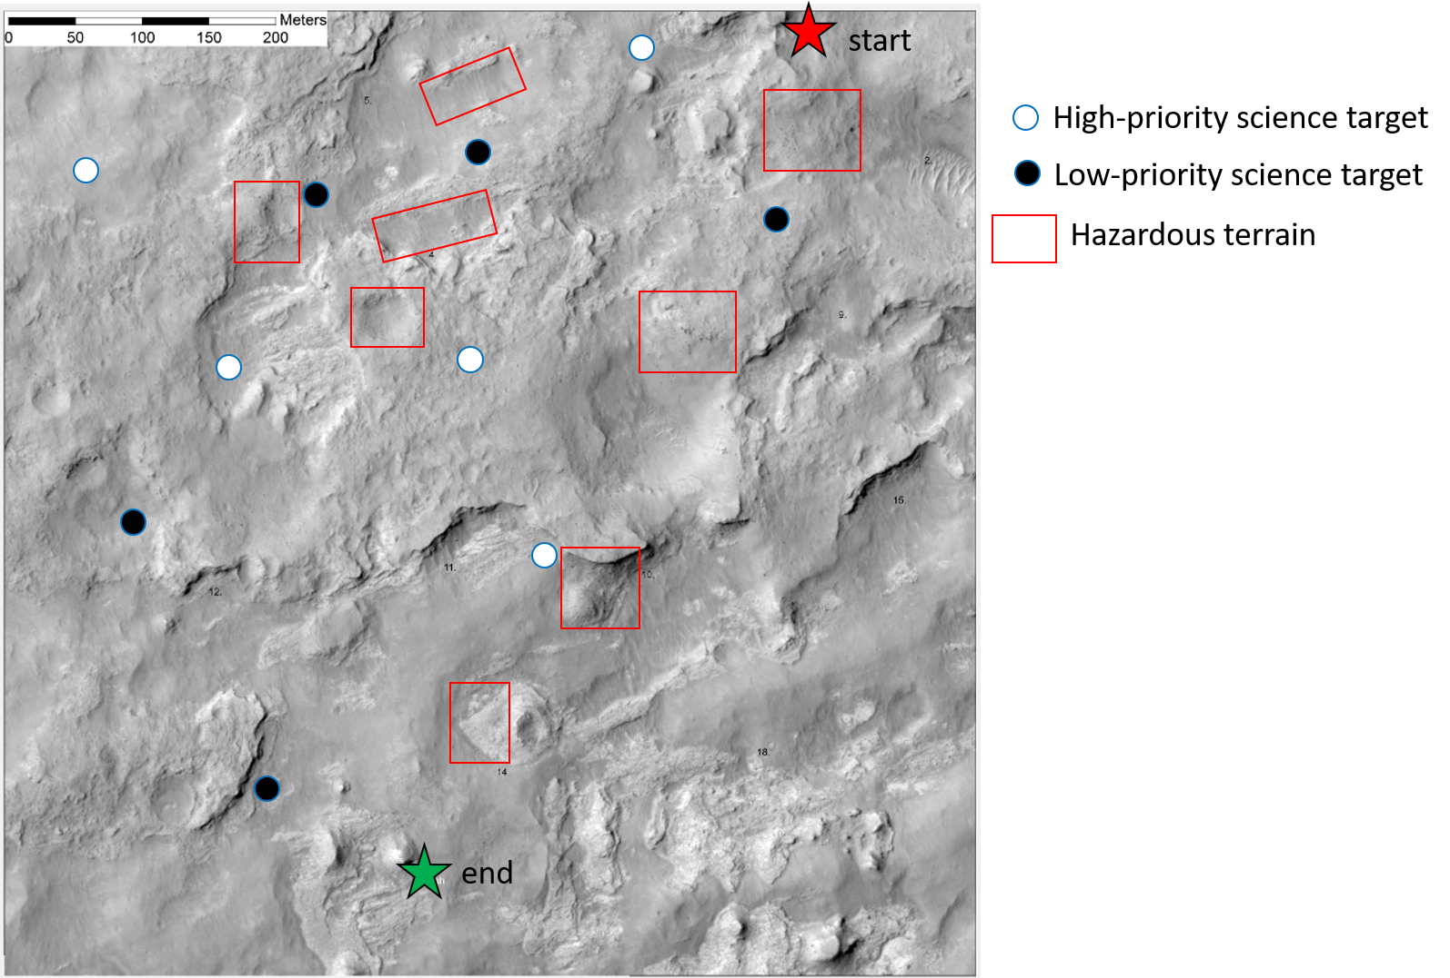
Activities
Roving on Mars Activity:
Use a robotic mouse and a map of Mars to program around hazards (Kit D)
OR have patrons plan a route using a map you print and distribute
OR plan the route using a map you share on your screen.

Slide 14
Activities
Searching for Alien Life Activity:
Searching for Life can be conducted as a demonstration.
You and Dr. Lynch will invite your patrons to make observations and share conclusions. All of the materials are within Kit D.
Options:
Use additional camera?
Use IR camera or thermometer?
Use small scales to weigh samples?.
https://www.youtube.com/watch?v=19MsbyQgPT8

